Slide 1



MDCHS Academy of Science Team Pathfinders:
Ana Cardenas, Adrian Carretero, Vincent Dobrawa, Maria Garcia, JP Gonzalez,
Ray Holscher, Jorge Tagle
February 26, 2017

Slide 2
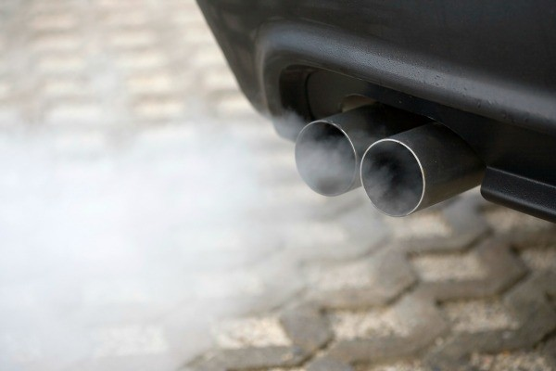
What public health problem are we solving?
C_{x}H_{y}•
CO
soot
NO_{x}
O₃
SO_{x}
Source: Centers for Disease Control and Prevention

Slide 3
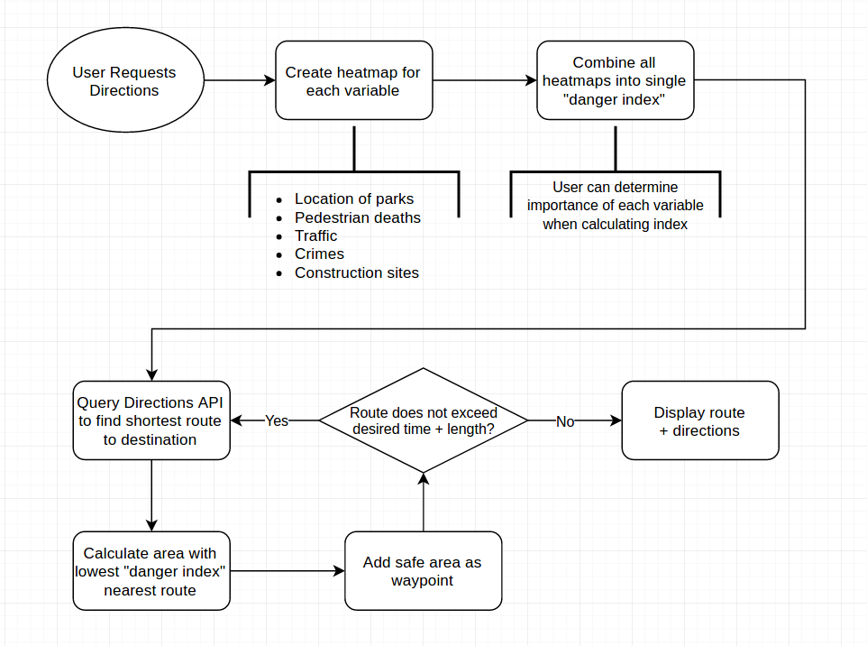
How does our app work?

Slide 4

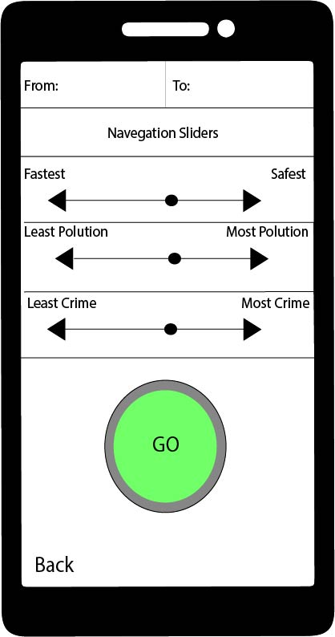
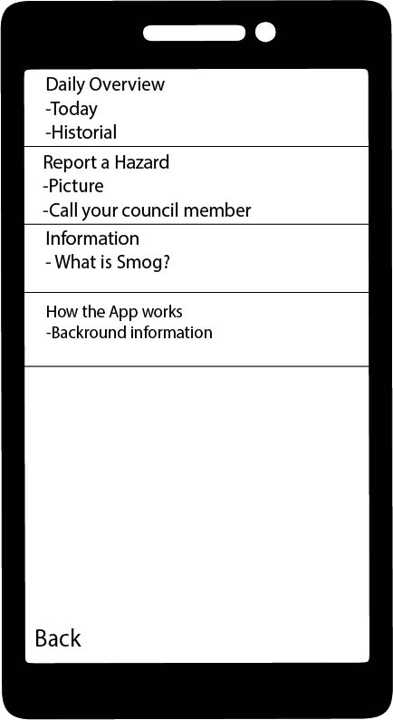

Slide 5
What data sets will the Intake app use?
Source data | Health/Safety Information
Air pollution Control District (APCD), County of San Diego | City pollutant overview: O₃, NO_{x}, CO*
Google API? | Real-time traffic data
San Diego Regional Data Library | Historical traffic data, by street segment
San Diego Police Department, 50 most dangerous intersections (2001-15) | Dangerous intersections
SANDAG | Bike routes, parks
San Diego Regional Data Library: Crime Heat Map | Potential crime hazards
Send someone out into the field | Industrial emissions
City of San Diego (CIP) Project List | Active Construction sites
Record rain setting day

Slide 6
Next steps
Code GUI
Figure out best way to query real-time traffic data
Code path-finding algorithm
Install a server and create user-reported hazard database
Figure out best way to query and assimilate the different datasets

Slide 7
Common air pollutants emitted from vehicles
Air pollutant | Chemical formula | Potential pulmonary health effects
Carbon monoxide | CO | Headaches, dizziness, vomiting, nausea; unconsciousness and death; increased rate of heart diseases
Nitrogen oxides | NO_{x} | Inflames the lining of the lungs; reduces immunity to lung infections; causes acute bronchitis; wheezing, coughing, colds, flu
Sulfur oxides | SO_{x} | Irritate the nose and throat airways; coughing, wheezing, shortness of breath, tight feeling around chest
Ozone | O₃ | Chest pains, coughing, shortness of breath, throat irritation; throat and lung tissue irritation; aggravation of asthma
Polyaromatic compounds | PAHs | Harmful effects on the skin, body fluids, and systems; difficulty during pregnancy; birth defects, decreased body weight
Free radical species | C_{x}H_{y}• | Inflammatory diseases (arthritis, lupus erythematous…); ischemic diseases (heart diseases, stroke…); neurological disorders
Soot particulates | C | Premature death, heart attacks, aggravated asthma, acute bronchitis; cancer; developmental and productive harm
Copper | Cu | Irritation to the nose, mouth and eyes; headaches, stomachaches, dizziness, vomiting, diarrhea; liver, kidney, and brain damage

Slide 8
Source: Centers for Disease Control and Prevention

